Slide 1
SAT extensions
Incremental SAT
Cardinality constraints + optimization
The Constraints Satisfaction Problem (CSP)

Slide 2
Incremental satisfiability
Many, perhaps most, applications of SAT in the industry, look like this:
ϕ
Examples:
Planning
Bounded Model-checking
SAT
yes
ok?
ϕ
no
Add/remove
clauses from ϕ

Slide 3
Incremental satisfiability
So we need to solve a sequence of similar problems: ϕ₁, ϕ₂, …
Can we do better than just restarting the process each time?
Yes! We can reuse some of the learned clauses.
But which ones ?

Slide 4
Incremental satisfiability
Let ϕ₂ = (ϕ₁ [ A) n B
i.e., added A clauses, removed B clauses.
Q: Which learned clauses can we reuse?
A: Everything learned for ϕ₁n B
How?
Two options: marking-based, assumptions-based.
In both cases we assume that B is known a-priory.

Slide 5
Incremental satisfiability/marking
Mark B clauses.
A clause inferred from a marked clause is marked as well.
ϕ₂ can reuse non-marked clauses.
Inferred from a B clause
other (can be reused).
()
A proof of ϕ₁

Slide 6

Incremental satisfiability/assumptions
What are assumptions ?
Part of the solver’s interface: SAT(ϕ, $l_{1},…,l_{n}$)
ϕ is the formula,
$l_{1},…,l_{n}$ are literals that are assumed to be true.
Notes:
The contradiction appears because we learned new clauses since the last time we visited that level.

Slide 7
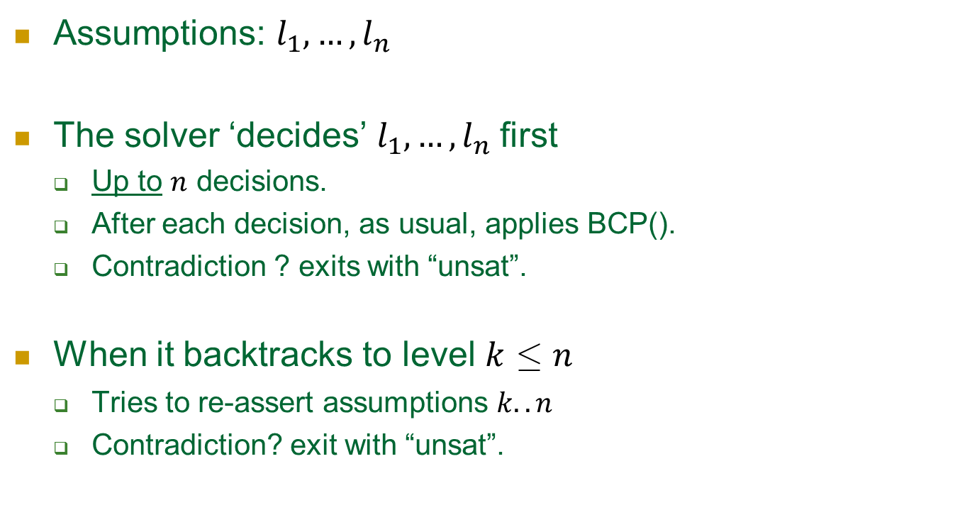
Incremental satisfiability/assumptions
Assumptions: $l_{1},…,l_{n}$
The solver ‘decides’ $l_{1},…,l_{n}$first
Up to $n$ decisions.
After each decision, as usual, applies BCP().
Contradiction ? exits with “unsat”.
When it backtracks to level $k$ · $n$
Tries to re-assert assumptions $k..n$
Contradiction? exit with “unsat”.
Notes:
Up to because some assumptions may imply others via BCP. If they imply the negation of another assumption => unsat.
The contradiction appears in later stages because we learned new clauses since the last time we visited that level.

Slide 8
Assumptions
What is this good for ?
Assumptions are modeled as decisions
Hence, everything that is learnt, is true regardless.
Conclusion: whatever is learnt can be reused in the next instance.
How can this be used for incremental satisfiability?

Slide 9
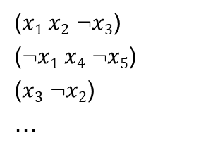

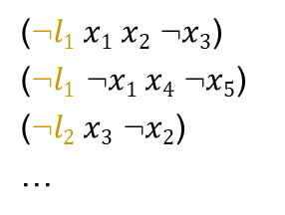
Incremental satisfiability/assumptions
Assumption literals are frequently used as clause selectors:
Setting $l1$=true activates “its” clauses
($x1 x2$ :$x3$)
(:$x1 x4$ :$x5$)
($x3$ :$x2$)
…
(:$l1 x1 x2$ :$x3$)
(:$l1$ :$x1 x4$ :$x5$)
(:$l2 x3$ :$x2$)
…

Slide 10
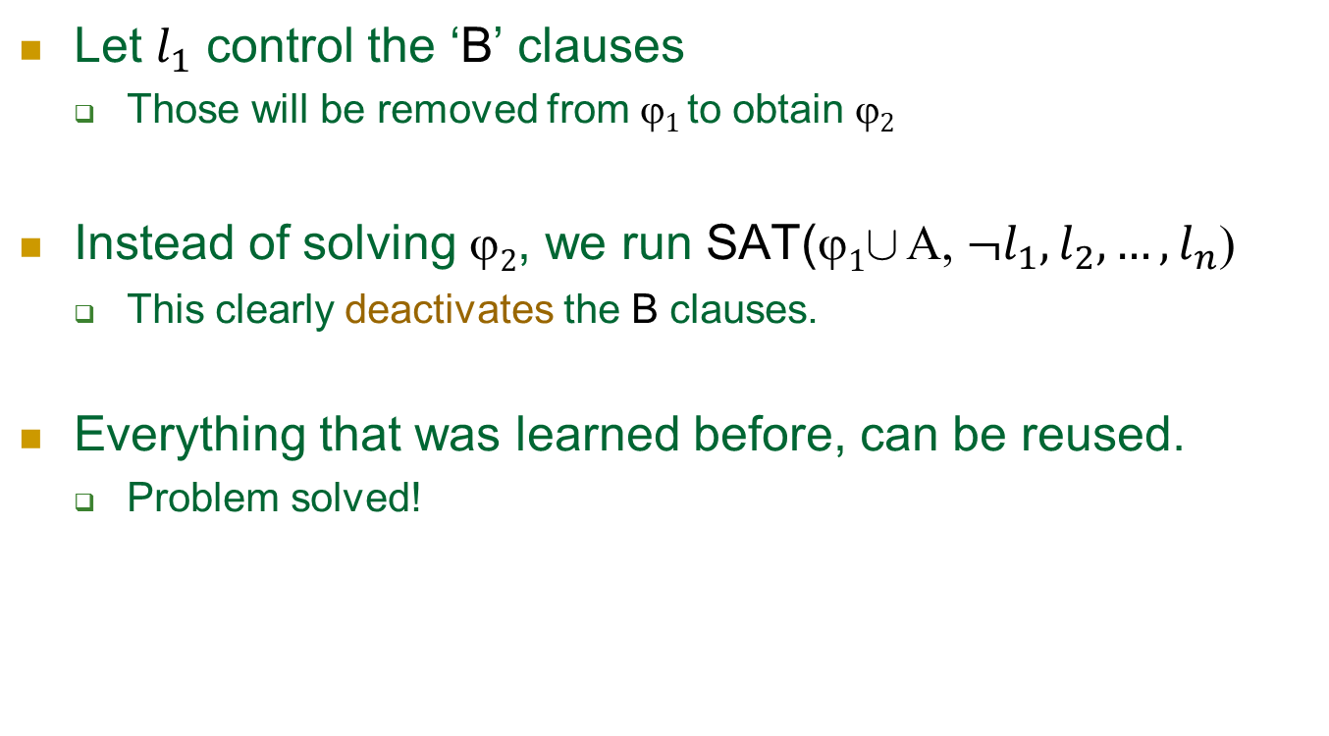
Incremental satisfiability/assumptions
Let $l_{1}$ control the ‘B’ clauses
Those will be removed from $1$ to obtain $2$
Instead of solving $2$, we run SAT($1$[ Α, $¬l_{1},l_{2},…,l_{n}$)
This clearly deactivates the B clauses.
Everything that was learned before, can be reused.
Problem solved!

Slide 11
Extensions
Incremental SAT
Pseudo-Boolean constraints + optimization
CSP – constraints solving problem

Slide 12
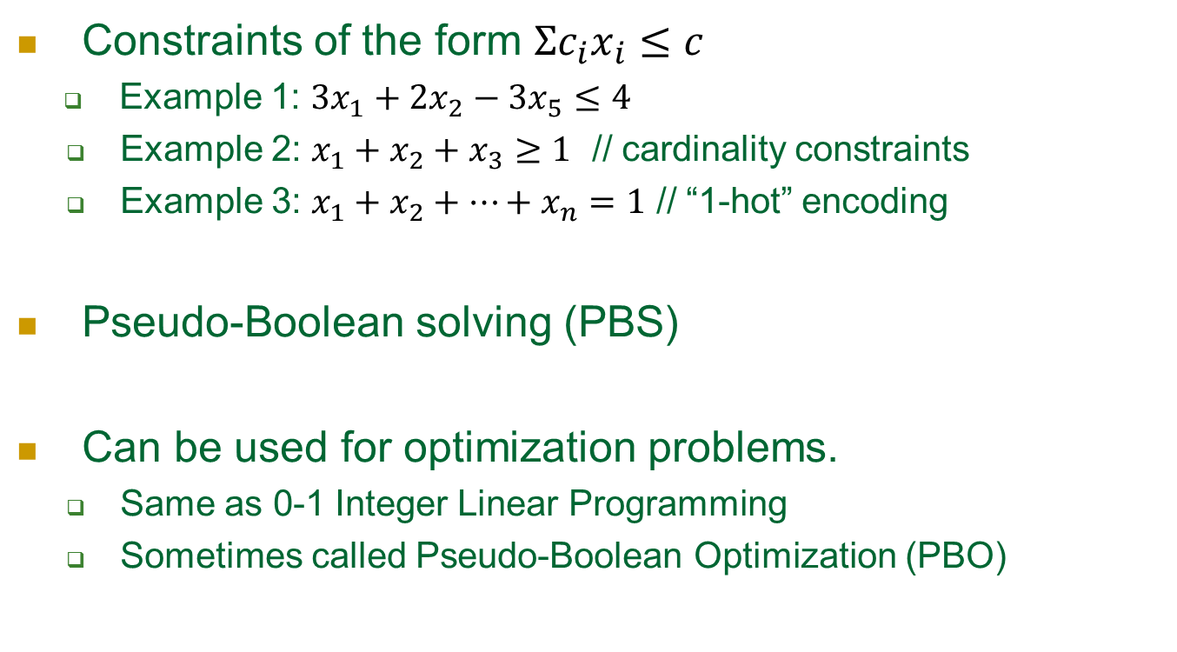
Pseudo-Boolean constraints
Constraints of the form $Σc_{i}x_{i}≤c$
Example 1: $3x_{1}+2x_{2}−3x_{5}≤4$
Example 2: $x_{1}+x_{2}+x_{3}≥1$ // cardinality constraints
Example 3: $x_{1}+x_{2}+…+x_{n}=1$ // “1-hot” encoding
Pseudo-Boolean solving (PBS)
Can be used for optimization problems.
Same as 0-1 Integer Linear Programming
Sometimes called Pseudo-Boolean Optimization (PBO)

Slide 13
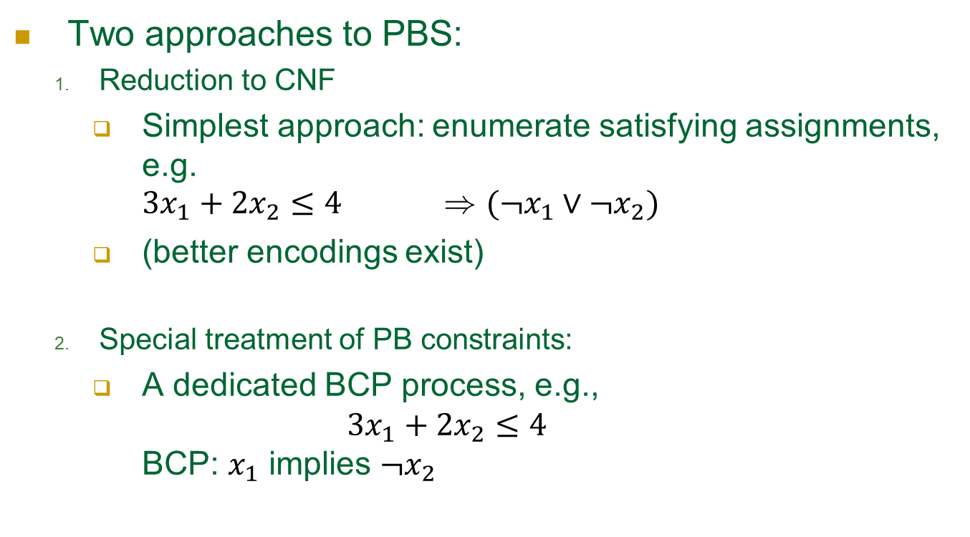
PBS
Two approaches to PBS:
Reduction to CNF
Simplest approach: enumerate satisfying assignments, e.g. $3x_{1}+2x_{2}≤4$ ) $(¬x_{1}∨¬x_{2})$
(better encodings exist)
Special treatment of PB constraints:
A dedicated BCP process, e.g., $3x_{1}+2x_{2}≤4$ BCP: $x_{1}$ implies ${¬x}_{2}$
Notes:
Solution and Optimization of Systems of Pseudo-Boolean Constraints /
Fadi A. Aloul, Arathi Ramani, Karem A. Sakallah, Igor L. Markov

Slide 14
What about the objective ?
ϕ – CNF, O – (min.) objective
e = 1;
While ϕ Æ (O < e) is SAT
Let ® be the solution;
e = ®(O);
return e;
Can you see the value of incremental SAT in here ?

Slide 15
Extensions
Incremental SAT
Cardinality constraints + optimization
CSP – the Constraints Satisfaction Problem

Slide 16
The Constraints Satisfaction Problem (CSP)
A higher-level modeling language than CNF
May result in a much smaller / readable model
Some constraints are solved faster natively.
In some cases in P rather than in NP

Slide 17


The Constraints Satisfaction Problem (CSP)
Examples of popular constraints:
AllDifferent($x_{1},…,x_{n}$): $x_{1},…,x_{n}$ must have different values
NoOverlap($x,d_{1},y,d_{2})$
x₂
x₁
≠
x₃
x₅
x₄
$$\left(x+d_{1}<y\right)∨(y+d_{2}<x)$$
y
d₂
d₁
x

Slide 18
The Constraints Satisfaction Problem (CSP)
Example CSP formula:
x < y Æ y < z Æ :allDifferent(x,y,z)
The classic CSP is restricted to finite discrete domains

Slide 19
Main steps – SAT and CSP*
SAT
CSP
“Decide”
Variable, value
“Boolean Constraints Propagation (BCP)”
infer implied assignments
“Analyze conflict”
applies learning
computes backtracking level
Same
“Constraints Propagation (CP)”
same
Adapted to general constraints
*As implemented in HaifaCSP

Slide 20
About that “Constraints Propagation (CP)”
Each constraint is accompanied with its own propagator.
the equivalent of BCP in SAT
Example: Given x₁ , x₂ , x₃ 2 [1..3], AllDifferent(x₁ , x₂ , x₃ ) CP: x₁ = 1 ) x₂ , x₃ 2 [2..3]

Slide 21
CSP and SAT
So what is better in terms of run-time, CSP or SAT ?
Currently SAT seems to lead in most cases, but definitely not always.
They constantly steal ideas from each other

